Slide 1
AMP ENERGY 2018
“Competition”
TV :30

Slide 2
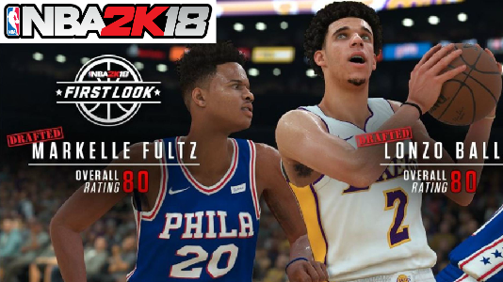
SCENE 1
VIDEO
AUDIO
OPEN ON CU OF GAMING SCREEN SHOWING TWO PLAYERS
GAME IS TIED IN OVERTIME
SFX OF GAME

Slide 3
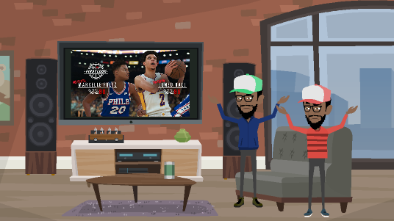
SCENE 2
VIDEO
AUDIO
CUT TO LS OF LUCAS BROTHERS PLAYING 2K, THEY GROAN IN FRUSTRATION AS THEY TIE AGAIN, THROWING UP THEIR HANDS IN UNISON
KENNY AND KEITH: Why does this keep happening?
SEEKING TO EASE THEIR STRESS, THEY NOTICE A CAN OF AMP ON THE TABLE

Slide 4
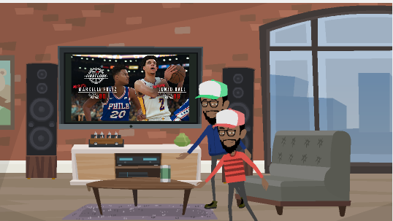
SCENE 3
VIDEO
AUDIO
CUT TO MS OF KENNY AND KEITH REACHING FOR THE AMP IN UNISON
TENSE MUSIC

Slide 5
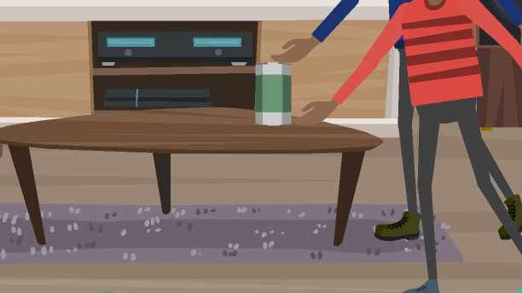
SCENE 4
VIDEO
AUDIO
CUT TO CU OF KENNY AND KEITH’S HANDS TOUCHING THE CAN OF AMP AT THE SAME TIME
MUSIC CRESCENDOS THEN STOPS

Slide 6
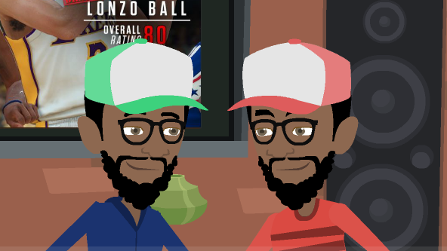
SCENE 5
VIDEO
AUDIO
CUT TO CU OF KENNY AND KEITH STARING AT EACH OTHER INTENSELY, WAITING TO SEE WHO WILL GIVE UP FIRST. AFTER A SILENT PAUSE THEY REALIZE IT WILL HAVE TO BE A CONTEST.
KEITH: Play for it?
KENNY, GLANCING BACK AT TIED SCORE ON THE SCREEN: Let’s take it to the next level.

Slide 7

SCENE 6
VIDEO
AUDIO
CUT TO MONTAGE OF KENNY AND KEITH PLAYING BASKETBALL POORLY IN THE PARK
INTENSE MUSIC THROUGHOUT

Slide 8

SCENE 7
VIDEO
AUDIO
MUSIC STOPS
CUT TO CU OF KENNY AND KEITH PANTING
KENNY AND KEITH STARE AT EACH OTHER, DEBATING THEIR DESIRE TO EXERT THEMSELVES FURTHER. SUDDENLY THEY HAVE AN IDEA.
KEITH: Let’s take it to the next level.

Slide 9
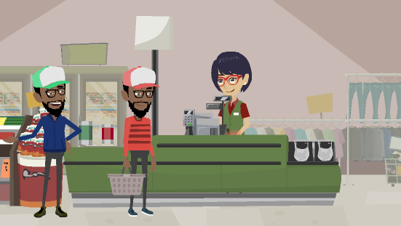
SCENE 8
VIDEO
AUDIO
CUT TO MS OF KENNY AND KEITH AT THE STORE BUYING AMP
UPBEAT YET MELLOW MUSIC PLAYS FAINTLY THROUGH STORE SPEAKERS
KEITH: Play smarter
KENNY: Not harder.
KEITH: Or harder if that’s your thing man.
KENNY: You do you.

Slide 10
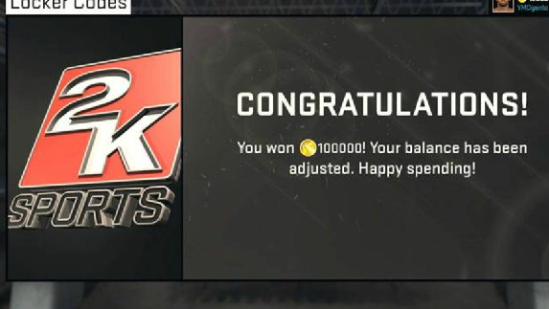
SCENE 9
VIDEO
AUDIO
CUT TO CU OF 2K SCREEN SHOWING KEITH AND KENNY REDEEMING THEIR VC CREDITS FROM THEIR AMP CANS
SFX OF GAME
SOUNDS OF KENNY AND KEITH HAVING FUN PLAYING 2K
MALE VO: With delicious flavors and the energy you need, AMP is the energy drink choice that takes you to the next level. And with VC credits on every AMP can, getting to the next level is more exciting than ever.

Slide 11
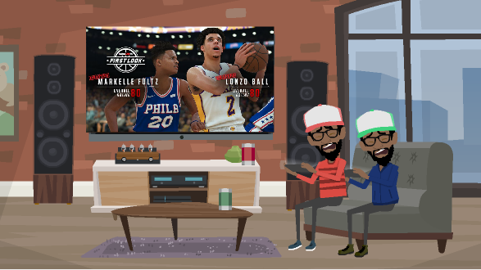
SCENE 10
VIDEO
AUDIO
CUT TO MS OF KENNY AND KEITH PLAYING 2K, THEY TIE AGAIN BUT THIS TIME WITH TWICE AS MANY POINTS AS BEFORE
KENNY AND KEITH: C’mon, man!
SFX OF GAME
UPBEAT MUSIC

Slide 12

SCENE 11
VIDEO
AUDIO
CUT TO MS OF AMP PRODUCT LINEUP
set you apart, they put you ahead. Choose AMP. Get ahead.
UPBEAT MUSIC FADES

